Slide 1
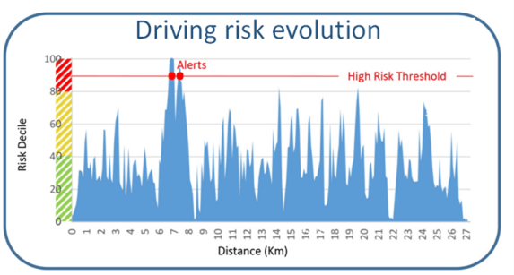

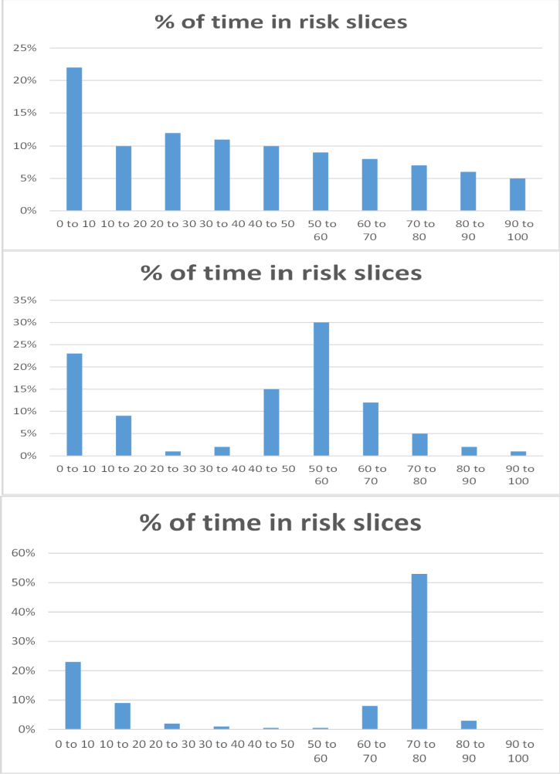


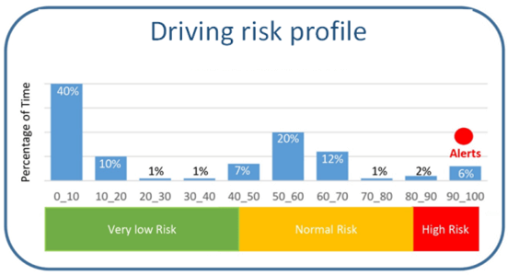

DRIVING SCORE PRINCIPLE:
UNIQUE SET OF DATA TO PROFILE DRIVER
Automatically regognize driver category, follow improvement among time, give awards when driver gets better, …
In real time during driving we record assessed risk 20 times per second
TYPICAL PROFILES
YOUNG / INEXPERIENCED DRIVER
Automatically set risk targets to adap advices and ACC to driver
EXPERIENCED DRIVER
Extract from profile: ability to reproduce risk (skills), risk appetite (self-confidence), ability not to enter triangle of risk (anticipation)
At the end of trip we compute HISTOGRAM of this curve that gives us THE DRIVER’s PROFILE
Driver’s mood (angry, tired, …)
Driving style
PILOT

Slide 2
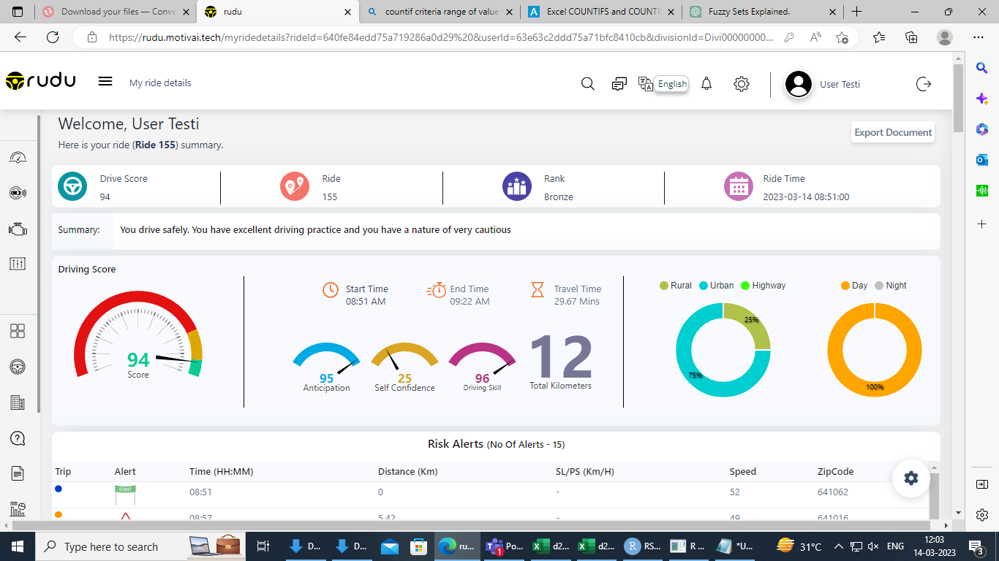
Ride_155
Ride_155 , was Happened from ( 2023-03-14 03:21:49:934 to 2023-03-14 03:52:02:010 ) so it was happened for 30 Minutes 13 seconds , therefore the the total seconds is 1813 seconds , Per Each Second the Risk count Calculated for 20 times
The Total Risk count Should be 1813*20= 36260 Risks counts for this Ride
From 36260 Risk ,The AI calculated the “Anticipation” , “Self-Confidence”, “Driving_skill”

Slide 3
Previous Slide we had seen that AI Scores , Now we will Do it in manually how the AI calculating the “Anticipation”, “Self-Confidence”, “ Driving-Skill”…….
Anticipation= Percentage that How much Risks Driver Avoided from (90-100) Risks
Self-Confidence = Drivers Risk Percentage , Where He Maintained Higher Risk percentage count in the Risk Distribution Chart
Driving-Skill= From the Self-Confident Bar , How much He avoided the Dispersion of Risk –Values ,In other Form , The Driver Repeats the Same Risks

Slide 4
For Ride no :155 , The Driver made his Ride for 30 Minutes and 13 seconds , The Total Risk count Should be 1813*20= 36260 Risks counts for this Ride
We have got the Risk counts data has 23603 Values
By using this Risk counts , we are going to calculate (“Anticipation” , “Self-Confidence”, “ Driving-Skill” )
First we will plot the Risk Values for 23603 datas

Slide 5
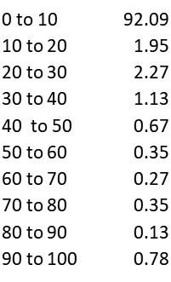
From the above Graph , I have arranged the Datas in X-axis as Interval and Y-axis as Percentage of that Risk counts

Slide 6
In the Last-Graph Driver maintained his Higher Risk_values in (0-10) interval , Since it is two low risk values , it should was considered to be as Risk_Free or Null Risk
So , We neglect that Bar , after the graph will be
Self-Confidence (28.71)
Driving_Skill=97.1
Anticipation = 91.2

Slide 7
Since the Driver Maintained High Risk counts in (20-30) Interval , So his Self-Confidence score will be “28.71” , and his Depression value at (20-30) range Risk is 2.9, So Driving_Skill= 97.1 ,
The Driver made 9.80% at Red-Risk Counts , So Antiicpation= 91.2 ( How much He avoided Red Risks )
Due to Some Missing Datas , We had Approached a Nearest Values of Anticipation , Self-Confidence , Driving-Skill
AI- Anticipation | 95
Calculated-Anticipation | 91.2
AI-Self-Confidence | 25
Calculated-Self-Confidence | 28.71
AI-Driving-Skill | 96
Calculated-Driving-Skill | 97.1

